Slide 1

Secure Digital Voting and Election Management System with Authentication Using Object-Oriented Programming in C++
DSA-0112 Object-oriented Programming in c++
Presented by :
CH. Venkata Chandu (192424140)
R.V Sreenivasan (192521417)
S.Sanjay (192521058)
Under the supervision of:
Dr. I. Sudha
Professor/CSE
SIMATS ENGINEERING

Slide 2
Introduction
Traditional paper ballot systems may face issues such as counting errors, delays, and ballot tampering.
A digital voting system provides a secure and efficient method for conducting elections.
The system uses voter authentication to ensure that only eligible voters can cast their votes.
It is developed using Object-Oriented Programming (OOP) in C++ to improve security, transparency, and vote integrity.

Slide 3
Abstract
The project develops a secure digital voting and election management system using C++ and OOP.
It authenticates voters and prevents duplicate or unauthorized voting.
The system automatically records votes and generates accurate election results.
Compared with paper ballots, it offers better security, faster processing, and improved transparency.

Slide 4
Problem Statement
Manual voting takes more time.
It is difficult to verify every voter manually.
A voter may try to vote more than once.
Manual counting can cause mistakes in results.
A digital system is needed for secure voting and easy election management.

Slide 5
Objectives
To develop a secure voting system using C++ and OOP.
To authenticate voters before voting.
To prevent duplicate voting and ensure vote integrity.
To provide fast and accurate election result generation.
To develop a secure digital voting system using C++ with voter authentication and accurate vote counting.

Slide 6
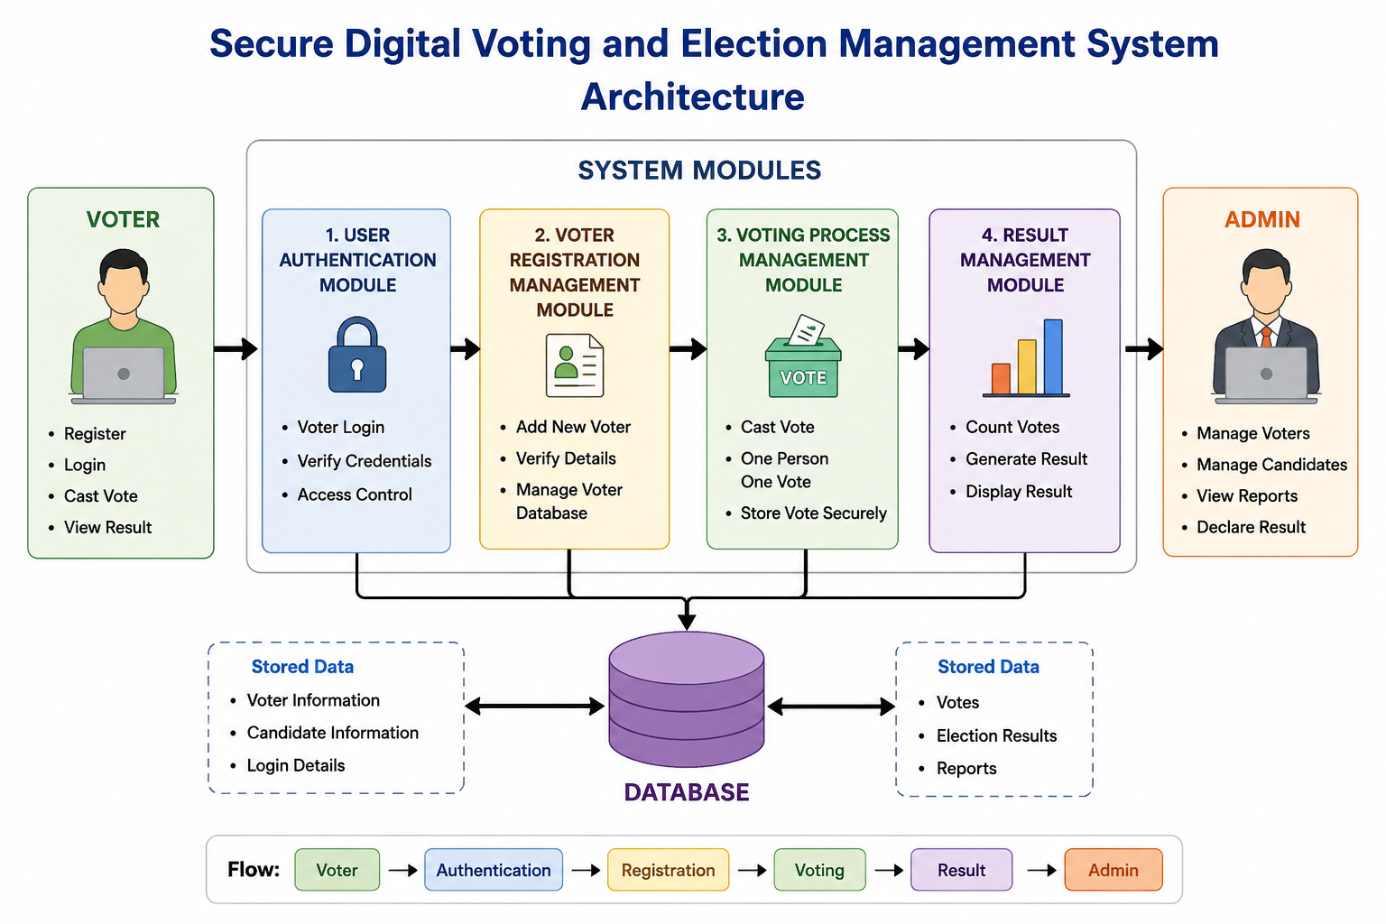

Slide 7
MODULES
Module 1
User Authentication Module
Module 2
Voter Registration Management Module
Module 3
Voting Process Management Module

Slide 8
Module 1
User Authentication Module
C++ Concept Applied: Encapsulation & String Manipulation via STL.
Role in Code: Handled by AuthManager::authenticate and the /api/login route.
Core C++ Logic:Uses std::string and string lookup methods (.find(), .substr()) to extract incoming JSON voter IDs and passwords.
Encapsulates authentication checks within AuthManager, querying stored user objects and matching credentials securely.
Rejects unauthenticated sessions by returning HTTP status 401 Unauthorized

Slide 9
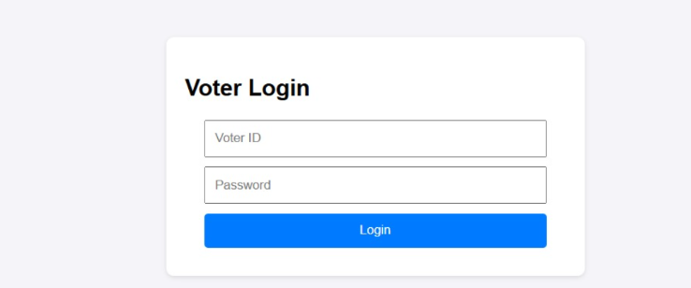

Slide 10
Module 2
Voter Registration Management Module
C++ Concept Applied: Object-Oriented Hierarchy (Inheritance), File I/O Streams (fstream), and Validation Logic.
Role in Code: Handled by Voter (model), AuthManager::registerUser, and PersistenceManager.
Core C++ Logic:Inheritance: Voter inherits common attributes (id, name, password) from the base User class.
Business Rule Validation: Enforces the legal voting age constraint (age >= 18) and verifies uniqueness against registered IDs before instantiation.
Data Persistence: Uses std::fstream to write new voter records to disk (data/voters.txt), ensuring durability across server restarts..

Slide 11
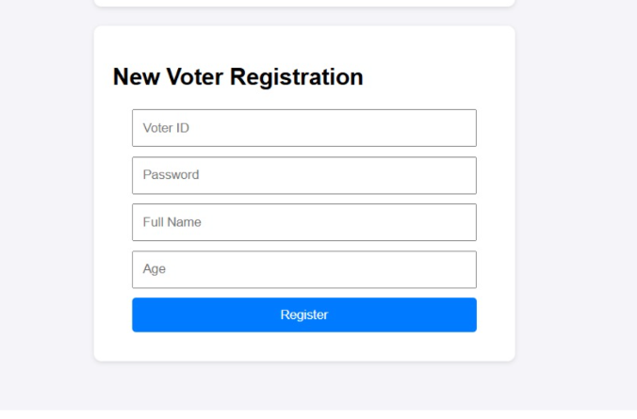

Slide 12
Module 3
Voting Process Management Module
C++ Concept Applied: Dynamic STL Containers (std::vector), Lambda Closures, and State Mutation.
Role in Code: Handled by ElectionManager::castVote, Candidate (model), and the /api/vote / /api/results endpoints.
Core C++ Logic:State Protection: Flags the hasVoted boolean on the voter object to prevent duplicate voting.
Container Traversal: Uses standard loops over std::vector<Candidate> to locate the selected candidate ID and increment the vote count (voteCount++).
Thread-Safe Routing & Serialization: Route closures ([&election]) capture references to process POST requests, immediately updating persistent files via PersistenceManager::saveCandidates and outputting live JSON tally data to the admin dashboard.

Slide 13
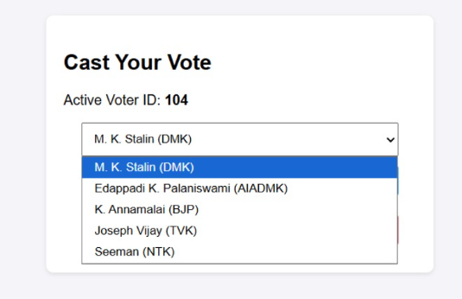
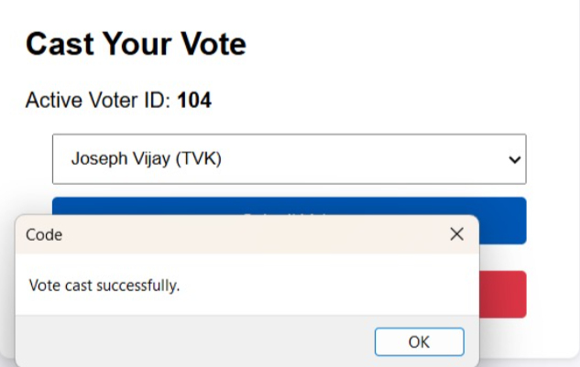
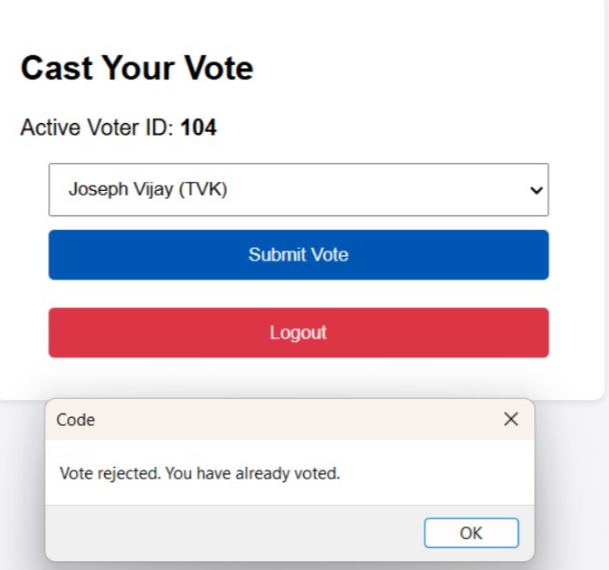

Slide 14
Conclusion
The proposed system provides a secure and reliable digital voting solution.
Authentication prevents unauthorized and duplicate voting.
Automatic vote counting reduces errors and saves time.
The system improves security, transparency, and vote integrity over conventional paper ballot systems.

Slide 15
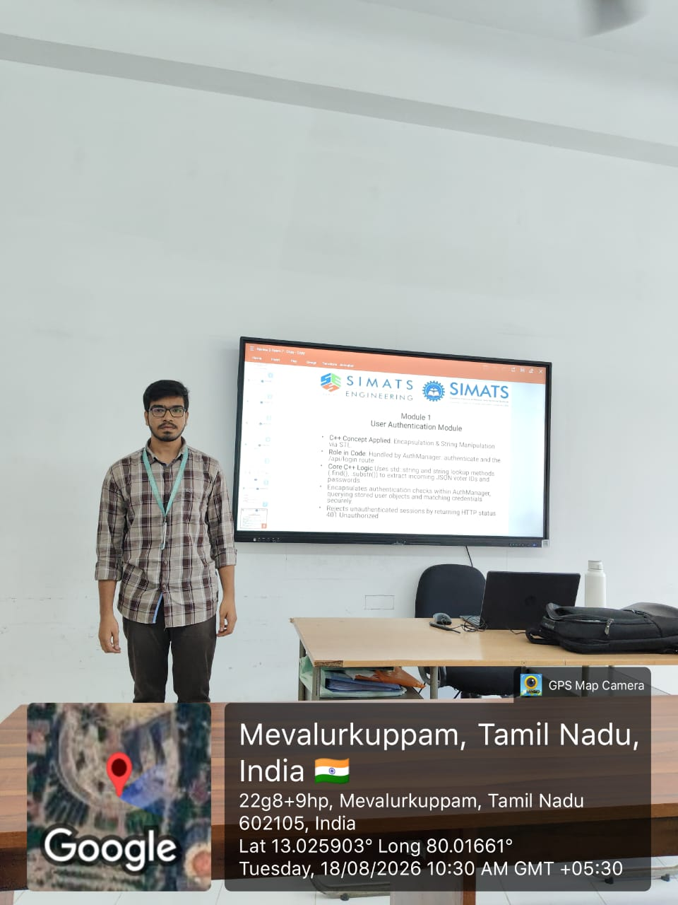

Slide 16


